Slide 1
Symphony
a musical test...
Test your track against the greatest compositions of all time...
-Kartik Vyas
-Devin Garg
-Anmol Gupta
-Aman Gupta
-Archit Dwivedi

Slide 2
Motivation behind the Project
Do you get inspired to pick up any instrument after listening to moving melodies, upbeat baselines and pleasant harmonies, but you soon give up when you are nowhere close to the original composition.
We began our journey to create Symphony a Signal processing tool which compares and quantize your performance to give you a good measure of similarity between your cover and original composition so that you can work on improving your score and are motivated enough to achieve perfection.

Slide 3
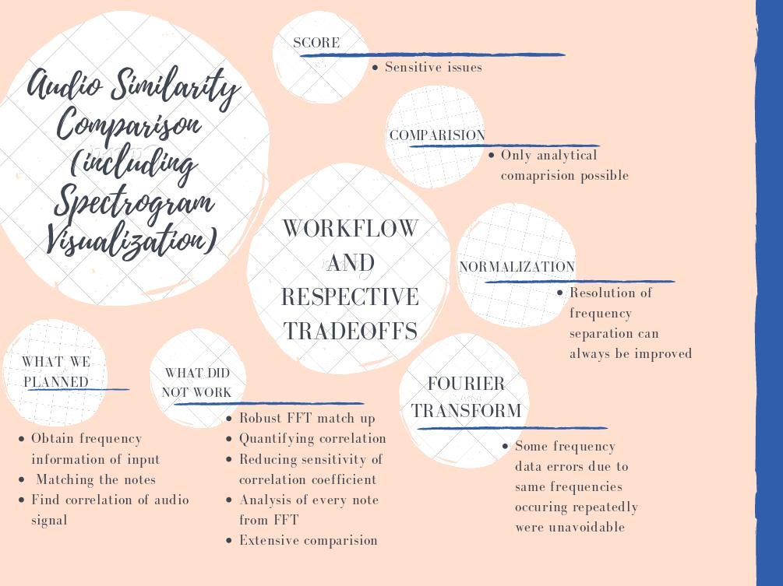

Slide 4

Workflow
Audio Similarity Comparison
Spectrogram Visualization
Similarity Check
(Of close range values)
SCORE !!
^{Your Cover}
DFT
Normalization
Of Close range values
^{Original}
^{Composition}
DFT
Normalization
Of Close range values
^{SAMPLE}
STFT
Spectrogram
Visualization

Slide 5

How we find DFT??
...(The Cooley-Tukey Algorithm)
The Cooley–Tukey algorithm, is the most common Fast Fourier Transform (FFT) algorithm. This algorithm breaks the DFT into smaller DFTs , and thus reduces the computation time to O(NlogN) for high values of N. This algorithm is based on recursive method.
Now let’s compare it with normal DFT algorithm.
As we know that the DFT mathematical expression is:
Where n is from n=0 to n=N-1
and k=0,1,2,3,..........,N-1

Slide 6
When we apply the built-in algorithm, where we use nested for loop, it’s computation cost will be of the order of O(N^2) which will be large if the value of N is large. Let’s take an example to understand this
Therefore, when N=10^9, the computation done by using direct FFT function would take approximate 31.2 years, on the other hand Cooley-Tukey will take only 30 sec.
N | 1000 | 10^6 | 10^9
N*N | 10^6ns | 10^12ns | 10^18ns
N*log(N) | 10^4ns | 20*10^6ns | 30*10^9ns

Slide 7
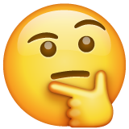
How to compare the frequencies played
What we have - the Fourier Transforms of the two signals.
What we want - A measure of comparison between the two sets of frequencies i.e. the frequencies with considerable contributions in the two signals.
Requirement: Completing the compare operation in reasonable time.
The problem: To stay within the time constraint we need to limit the number of samples we take into consideration.
So, considering 442 Hz, 439 Hz, 441 Hz, 440 Hz is not of any use as their contribution hardly has any difference.
So what to do?

Slide 8
The approach we went with- we used a sensitivity factor which would indicate the minimum gap between frequencies of similar contribution to consider them separately (otherwise we just take the contribution-weighted-average of nearby frequencies)
Before sending off the frequency data for similarity check.
For the similarity-check we employed the Pearson Correlation Coefficient which basically indicates the similarity of data sets, which in our case would yield the extent of common frequencies.

Slide 9
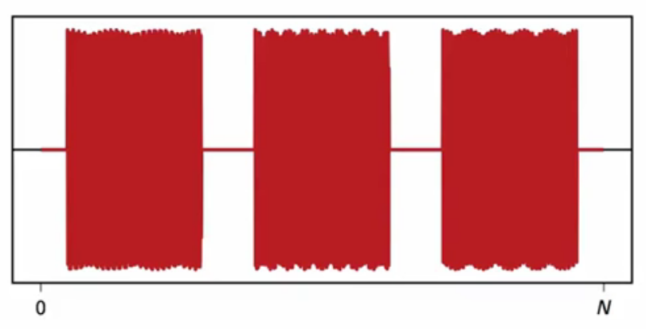
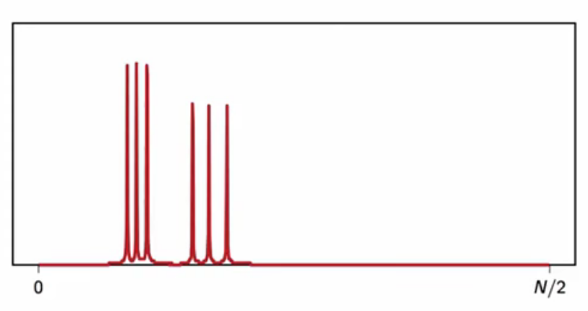
STFT- The Basics(What and Why)
Suppose we dial three DTMFs (Dual Tone Multi Frequency) keys. When plotted, the audio signal would have three bursts of sound, each corresponding to the three DTMF that we just dialed.
In order to tell with definite certainty which DTMF is dialed in what order, we use STFT.
Short Time Fourier Transform(STFT), is basically the Fourier Transform, taken over small time intervals, getting the frequency domain as time progresses.
This time varying spectral information can then be depicted using a spectrogram.

Slide 10
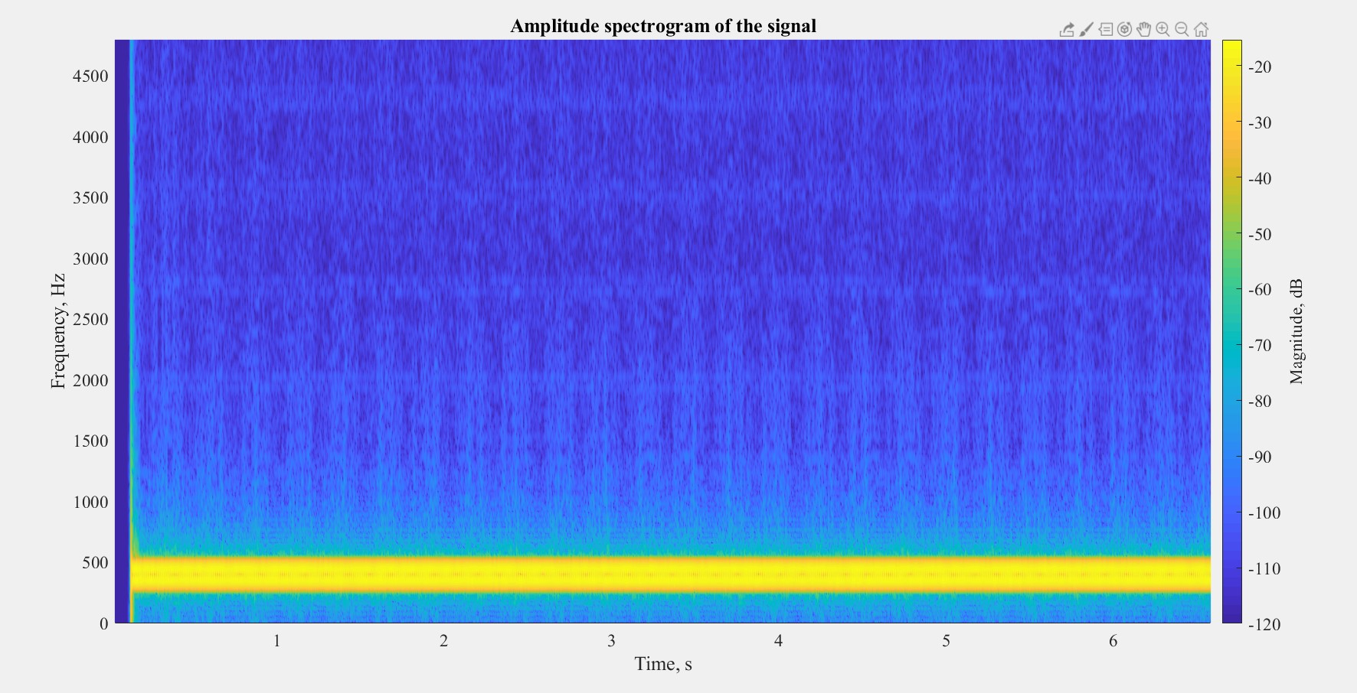
Spectrogram Visualization
Spectrogram is a visual depiction denoting the frequencies present in the audio track along with time.
The frequencies are represented on the Y axis, with time on the X axis.
The different colours and their intensities depicts the contribution of frequencies at a particular time.

Slide 11
OBSERVATIONS AND RESULTS
Signals | Similarity
Fur Elise - Fur Elise (Original composition vs. User attempt) | 0.9623
Fur Elise - US Dial Tone | 0.1572
US Dial Tone - US Dial Tone (two different sources) | 0.853

Slide 12
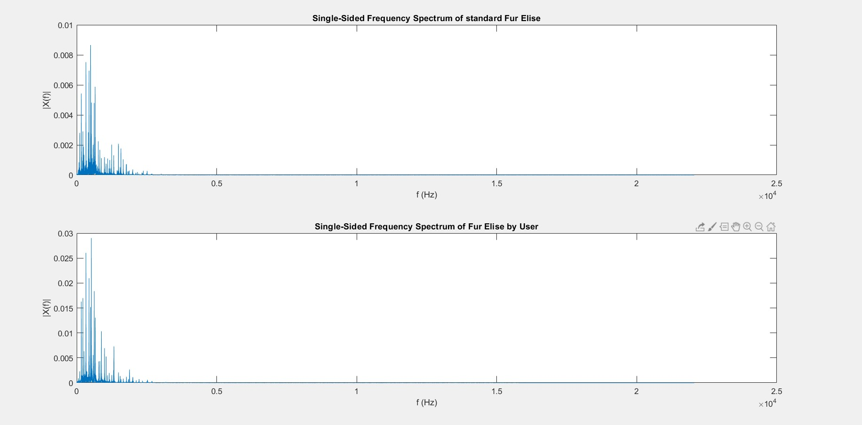
Fourier Transforms of standard composition and user’s input (Fur Elise)

Slide 13
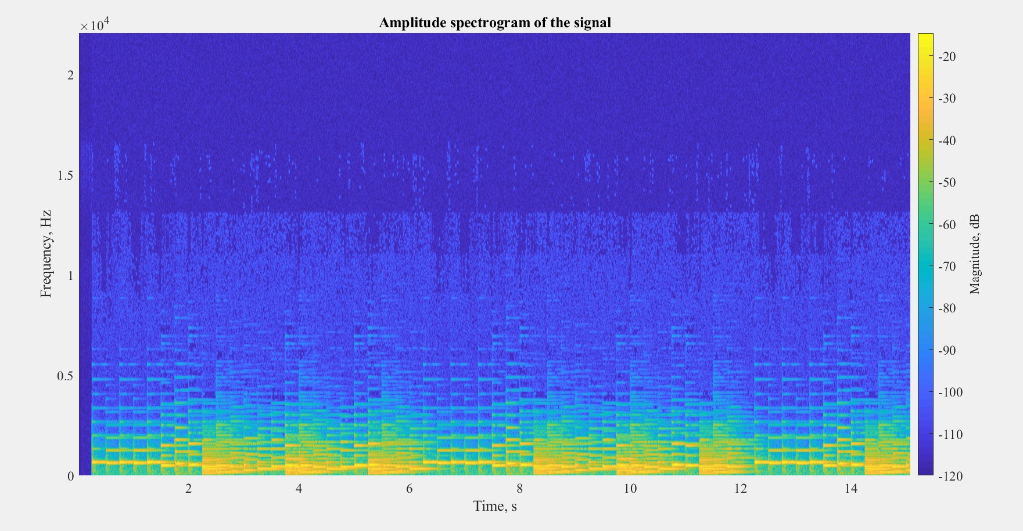
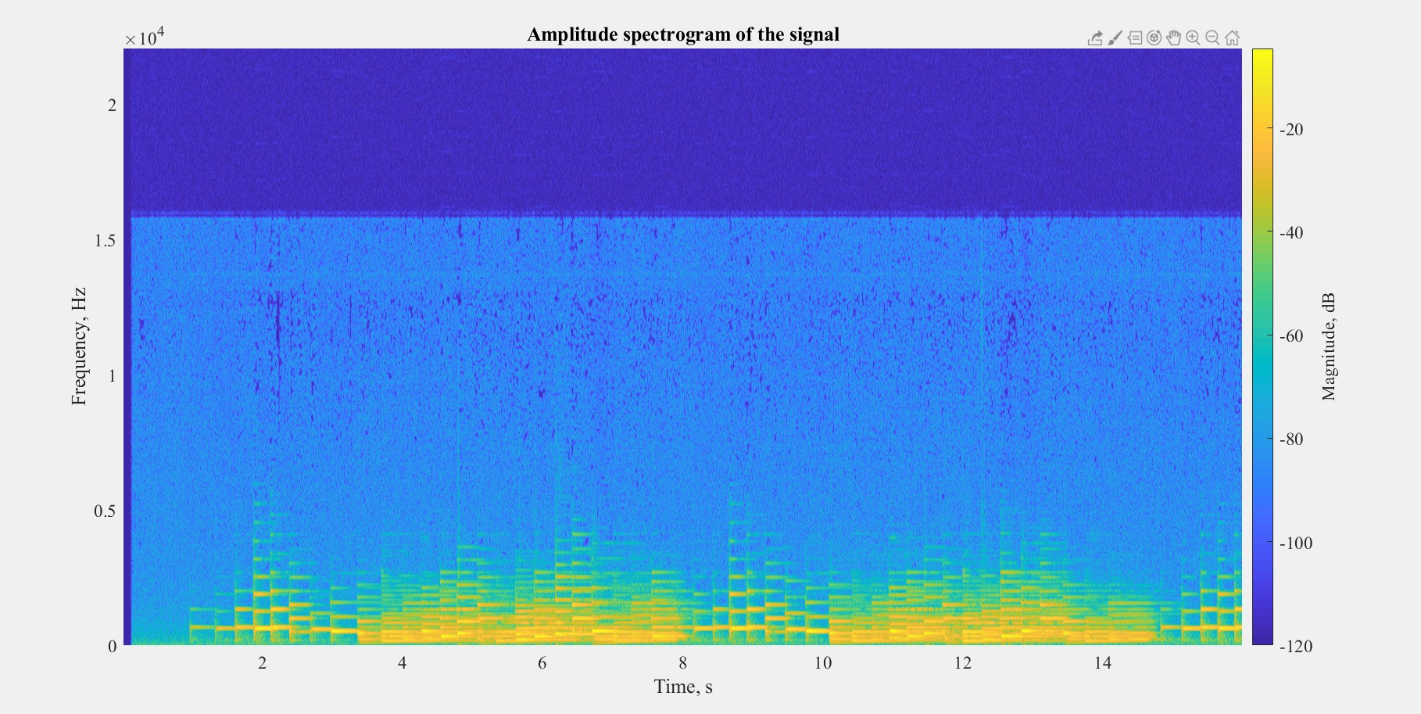
Spectrograms Comparison

Slide 14
CONCLUSION
Similarity of signals was found in two respects - first, a more numerical approach which gave the similarity with respect to the frequencies being played by the user as compared to the original composition (utilizing the DFT of the signals) and second, a visual comparison of spectrograms of the two signals leading to a time delay understanding of the signals.

